Slide 1



rws
The “React / Webpack / Sass” Stack

Slide 2
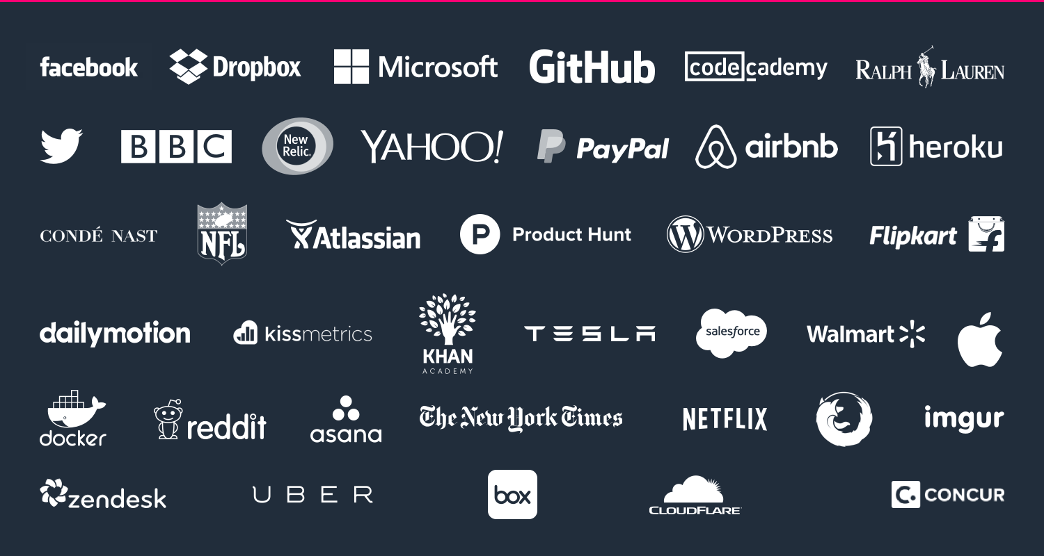
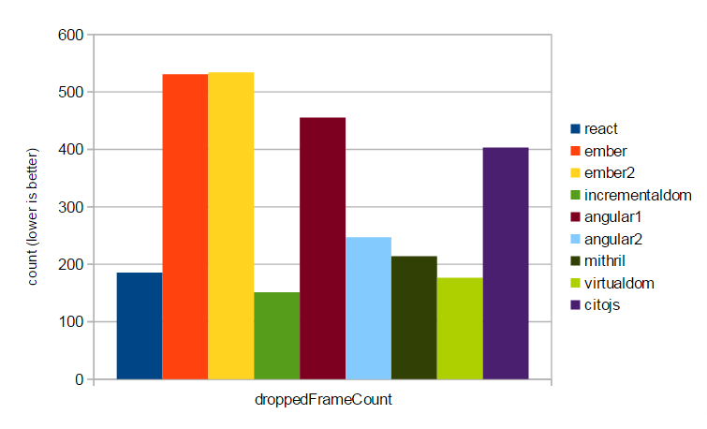

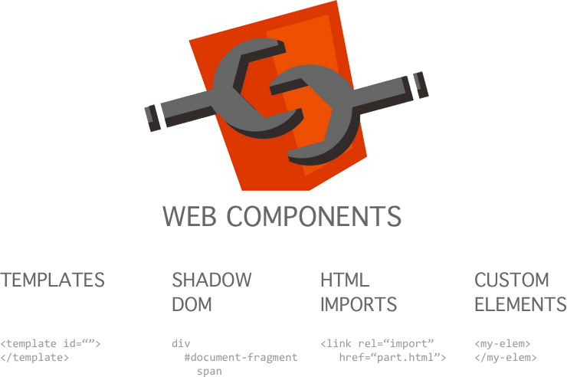

Why React?
Popular
Fast
Large community support
Flexible
Simple code
Easily integrate anything
Future Support
Productivity Focus
Web Components and ES6 ready
Less bugs

Slide 3


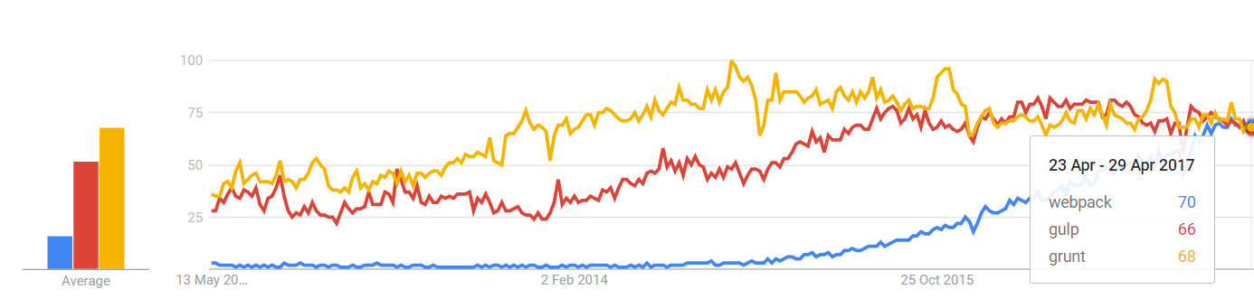
Why Webpack?
Variety of plugins
Designed for Webapps
NPM and Nodejs
1 stop shop
Addopted by React community
Build tools
Dev tools
Processors
Server
Hot Loading

Slide 4


Why Sass?
Hierarchy
Loops
Variables
Mixins
Modularity
Functions

